Slide 1
Retail Data Analysis
By Kavya Boban

Slide 2
Project Description
Retail Data Analytics is used nowadays by shops in order to better predict the number of products, that might get sold and therefore to better estimate how much product should be produced. This is very important because the amount of sold products can vary during the year.

Slide 3
The proposed system can therefore be used in order to optimize the production of products, such that there is always an optimal amount available. The proposed system RDA is used nowadays by shops in order to better predict the number of products, that might get sold and therefore to better estimate how much product should be produced.
By the development of the system the organization can easily predict the weekly sales for a store and visualize the data for better insight . This should then help to optimize the manufacturing process and thereby help to increase income while lowering costs.

Slide 4
Datasets
1. Stores
Anonymized information about the 45 stores,
indicating the type and size of store
Store | Type | Size

Slide 5
Features
Contains additional data related to the store, department, and regional activity for the given dates.
Store - the store number
Date - the week
Temperature - average temperature in the region
Fuel_Price - cost of fuel in the region
MarkDown1-5 - anonymized data related to promotional markdowns. MarkDown data is only available after Nov 2011, and is not available for all stores all the time.
CPI - the consumer price index
Unemployment - the unemployment rate
IsHoliday - whether the week is a special holiday week
store | date | temperature | Fuel_price | CPI | Unemployement | IsHoliday | markdown1 | markdown2 | markdown3 | markdown4 | markdown5

Slide 6
Sales
Historical sales data, which covers to 2010-02-05 to 2012-11-01. Within this tab you will find the following fields:
Store - the store number
Department - the department number
Date - the week
Weekly_Sales - sales for the given department in the given store
IsHoliday - whether the week is a special holiday week
Store | Department | Date | Weekly_sales | IsHoliday

Slide 7
Input/ Output and Modules identified
user should be able to enter a week and a store of interest and to get the predicted weekly sales as output
MODULES
Data preprocessing
Visualization
Training the model
Model evaluation

Slide 8
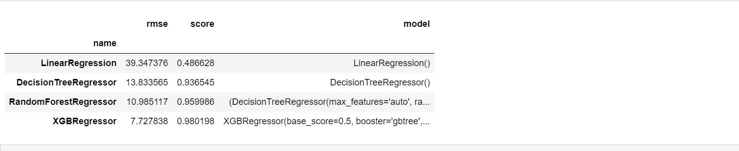
Algorithms to be used
Linear Regression
Random Forest
Decision Tree
XGBoost

Slide 9
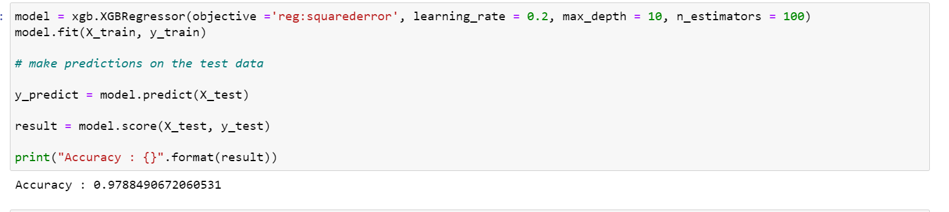
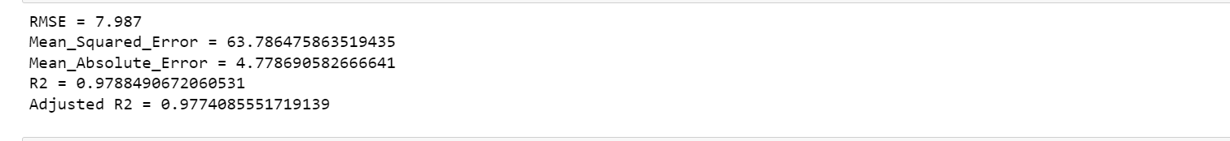
Accuracy

Slide 10
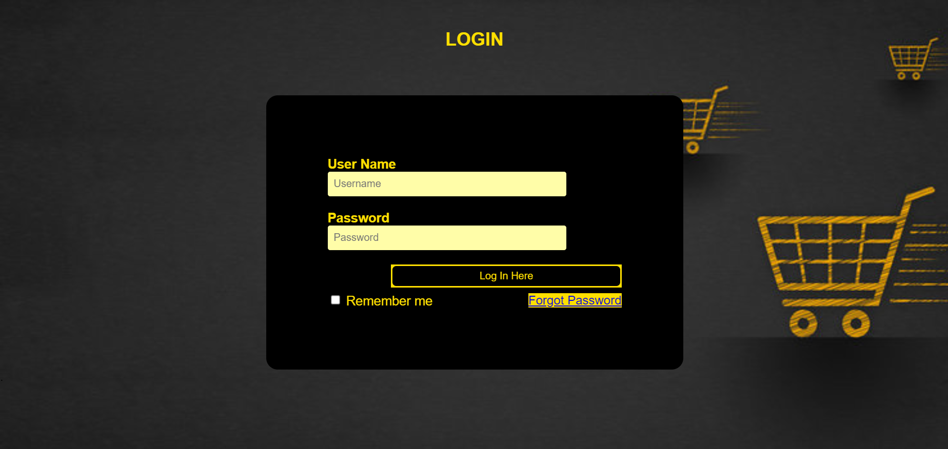
Screen shot

Slide 11
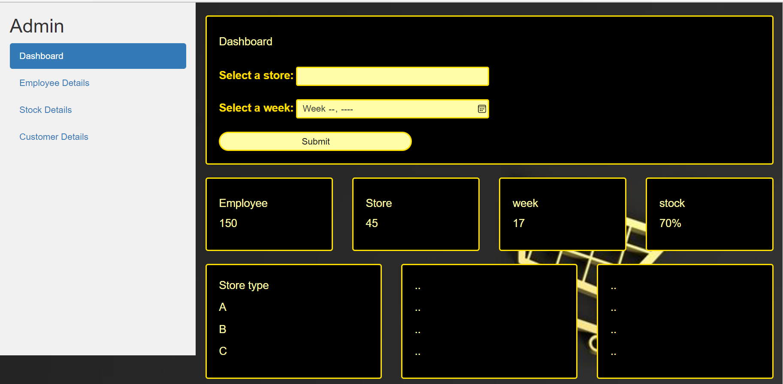

Slide 12
THANK YOU

